Slide 1

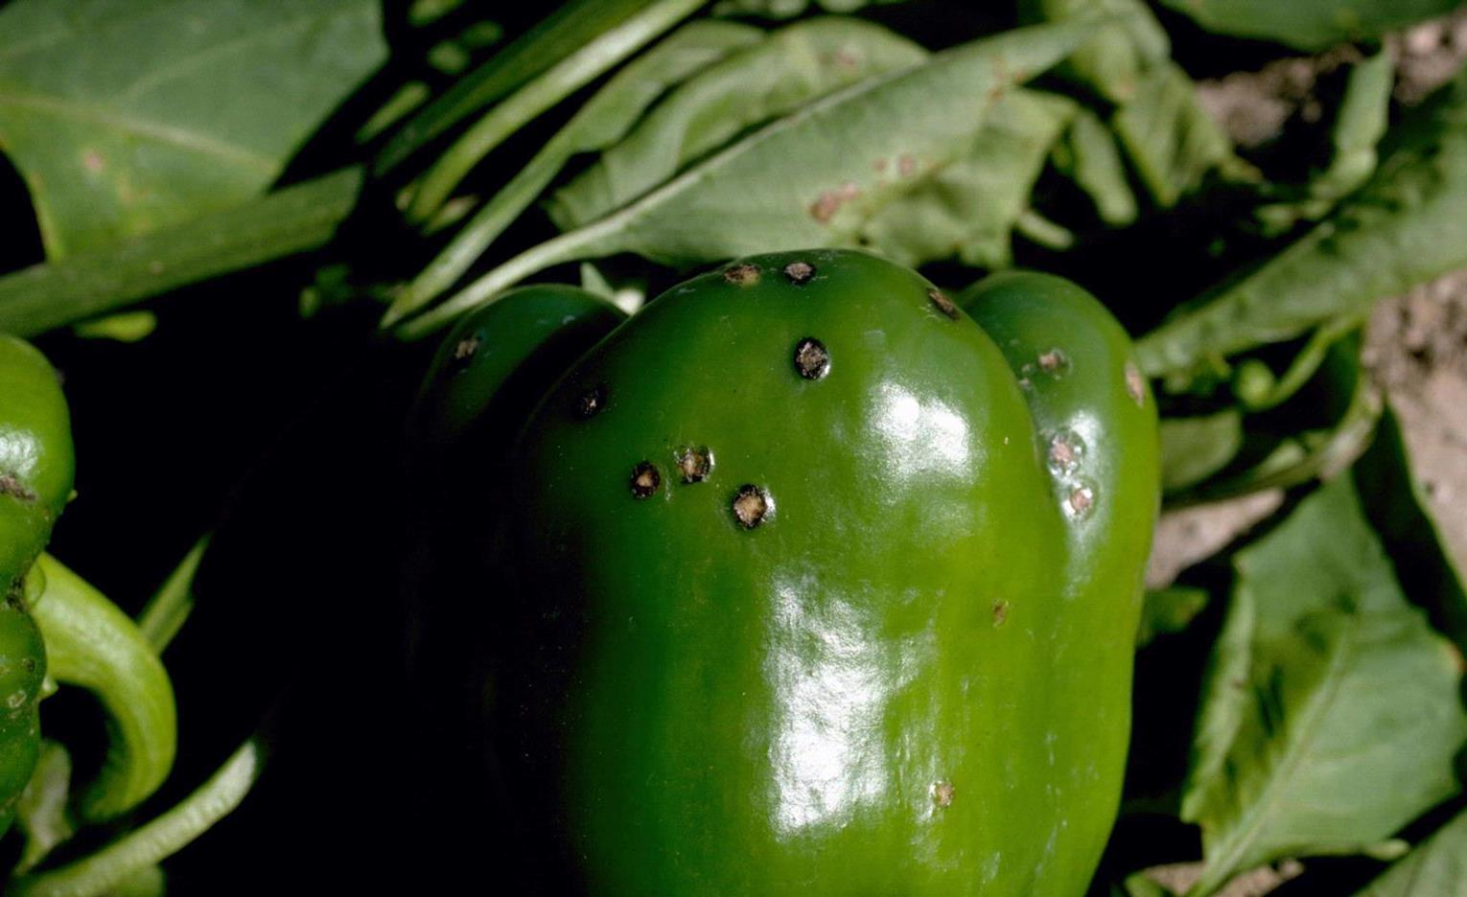
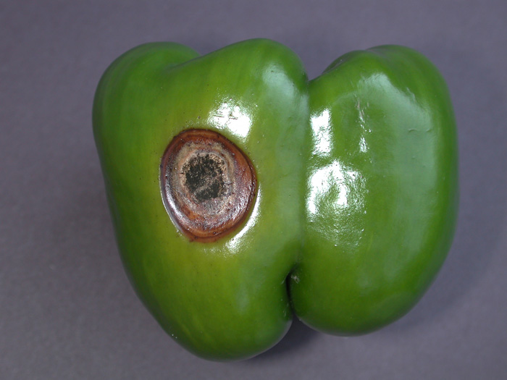
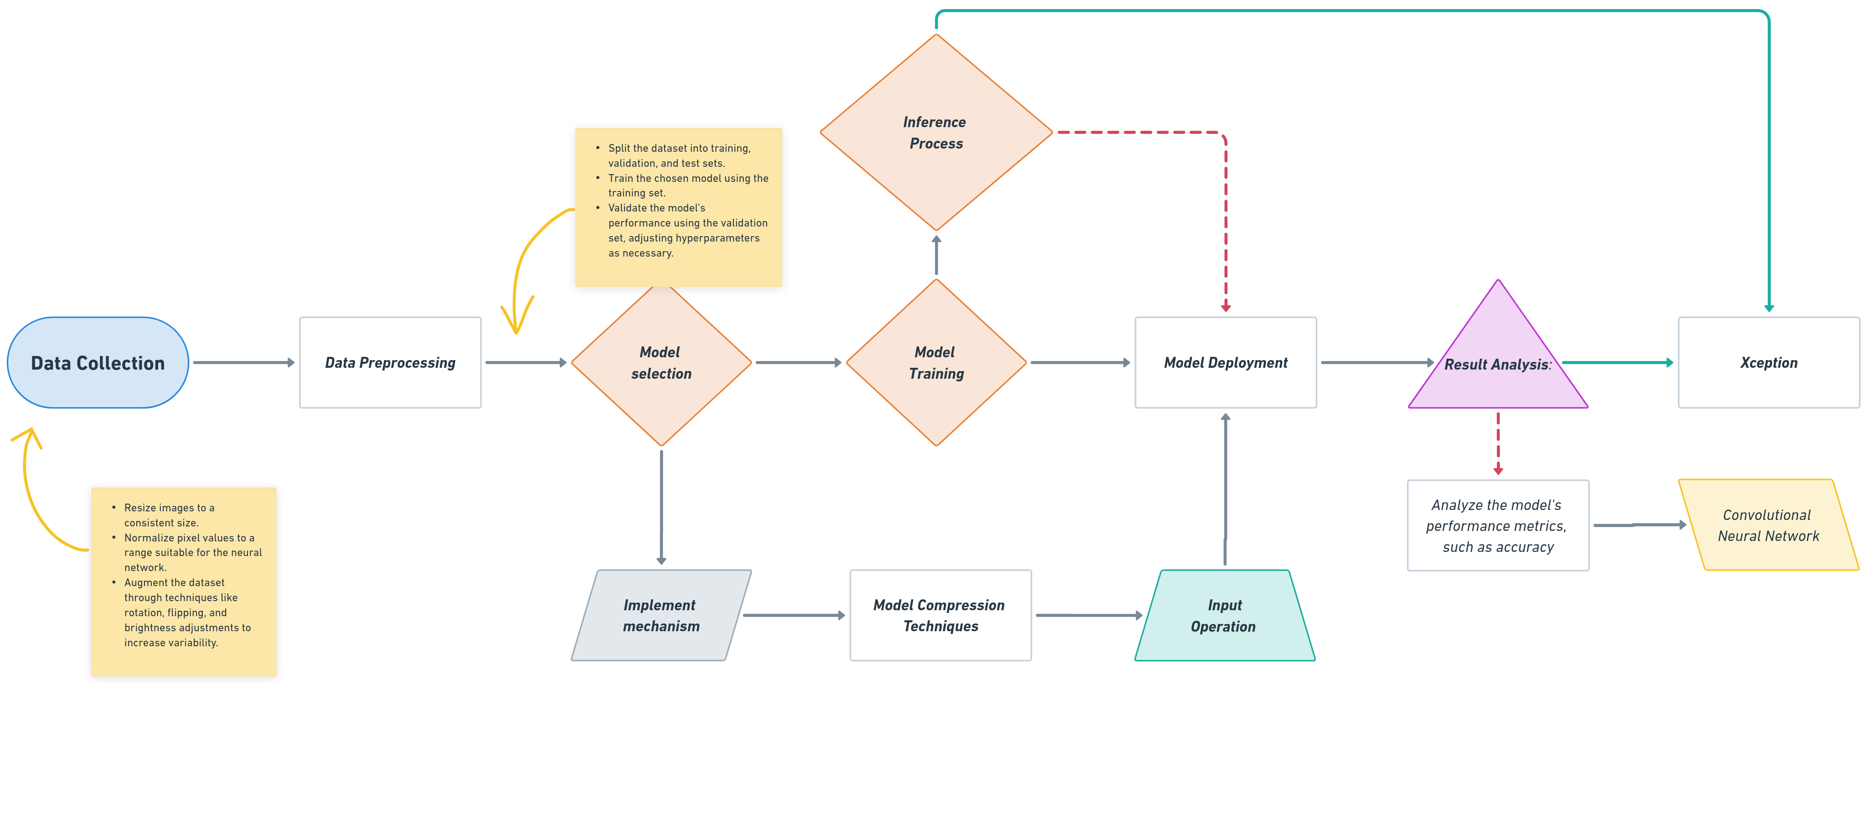

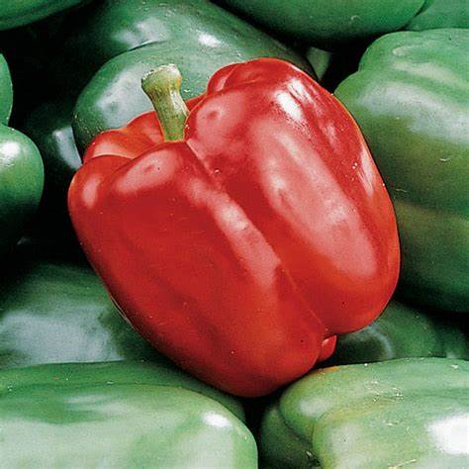
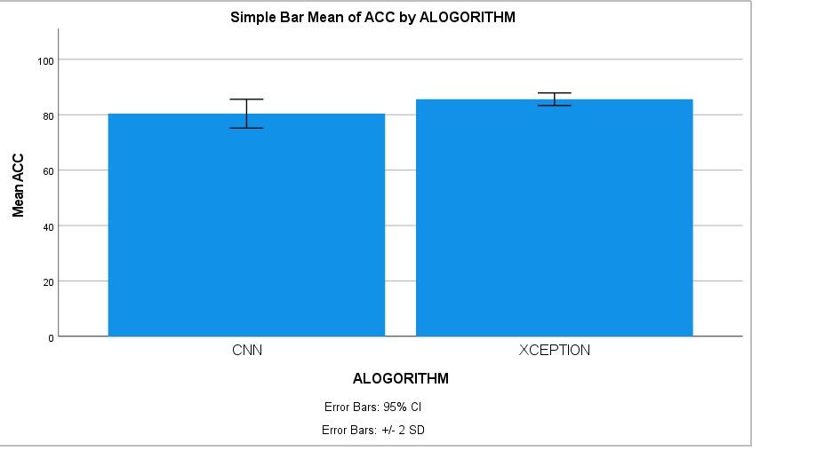
Name : Mr. Vigneshwaran P Register Number : 192124181
Guided by : Dr. C. Chandravathi
Ms. Poorani.S
Guided by Dr. Mary Valantina. G
Peppercheck: Deep Learning-based Bell Pepper Detection Disease using Convolutional Neural Network and xception method in the Safeguarding Crop Health through disease detection
INTRODUCTION
Bell pepper diseases encompass a range of fungal, bacterial, viral, and physiological disorders that can significantly impact crop yield and quality. Symptoms such as leaf spots, powdery mildew, blossom end rot, and viral mottling manifest, threatening the health and productivity of bell pepper plants.
Environmental factors, cultural practices, and pathogen presence contribute to disease development, necessitating vigilant management strategies. Growers employ cultural practices like sanitation and crop rotation, supplemented by chemical and biological control methods, to mitigate disease spread.
Additionally, resistant cultivars and integrated pest management approaches offer sustainable solutions for disease prevention. Ongoing research focuses on developing resilient varieties and innovative control measures to address emerging disease challenges. Ensure that the dataset represents the diversity of scenarios in which you expect the detection model.
We aim to develop a robust and precise system that contributes to the early identification and mitigation of diseases affecting bell pepper crops, thereby optimising agricultural practice.
Bell Pepper Detection Disease
MATERIALS AND METHODS
RESULTS
Collect images of bell peppers and preprocess them by resizing and normalizing pixel values.Model Selection: Choose between CNN and Xception for detection.Training Preparation in Split data into training/validation sets, possibly augmenting data.
CNN Training CNN, fine-tuning parameters based on validation performance.Xception Training: Train Xception, possibly using transfer learning, fine-tune parameters.Model Evaluation: Evaluate both models using a separate test dataset. Model Compare performance metrics of CNN and Xception. Choose the better-performing model for real-world deployment.
Visualization of the detection outcomes allows for a clear presentation of identified bell peppers within the input images from real-world usage informs further refinement of the deployed model to enhance its accuracy and robustness.
CNN and XCEPTION
Detecting bell peppers in images using Convolutional Neural Networks (CNN) and Xception Algorithm involves training these models on a dataset monitoring performance on the validation set to prevent overfitting. Use evaluation metrics such as accuracy and precision disease management is crucial for sustaining bell pepper production and ensuring food security
DISCUSSION AND CONCLUSION
Based on T-test Statistical analysis, the significance value of p=0.001 (independent sample T - test p<0.05) is obtained and shows that there is a statistical significant difference between the Group 1 and Group 2.
Overall , the accuracy of the Convolutional Neural Networks (CNN) is 85.61% and it is better than the Xception. Models undergo training on the training set, with adjustments made based on validation performance.
Convolutional Neural Networks (CNN) - 85.61%
Xception Algorithm - 80.40%
From the work, it is concluded that Convolutional Neural Networks (CNN) consistently demonstrate superior accuracy compared to Xception in the detection of bell pepper, highlighting the robustness and effectiveness of CNN architectures for image recognition tasks in agricultural contexts. A decision is then made between CNN and Xception architectures based on computational resources and performance requirements. The dataset is divided into training and validation sets, with potential augmentation techniques applied to increase variability.
BIBLIOGRAPHY
Ammon, Royce J. 2001. Global Television and the Shaping of World Politics: CNN, Telediplomacy, and Foreign Policy. McFarland. This seminal work examines the profound impact of global television, particularly CNN, on shaping international politics, telediplomacy, and foreign policy in the modern era.
Djeddi, Chawki, Yousri Kessentini, Imran Siddiqi, and Mohamed Jmaiel. 2021. Pattern Recognition and Artificial Intelligence: 4th Mediterranean Conference, MedPRAI 2020, Hammamet, Tunisia, December 20–22, 2020, Proceedings. Springer Nature. This conference proceedings volume presents the latest research and developments in pattern recognition and artificial intelligence, showcasing innovative approaches discussed at the 4th Mediterranean Conference.
Flournoy, Don M., and Robert K. Stewart. 1997. CNN: Making News in the Global Market. Delving into the rise and influence of CNN, this book provides an in-depth analysis of how the network has revolutionized news broadcasting and its impact on the global media landscape.
Gururaj, H. L., A. D. Radhika, C. D. Divya, Kumar V. Ravi, and Yu-Chen Hu. 2023. Intelligent Systems in Healthcare and Disease Identification Using Data Science. CRC Press. This comprehensive volume explores cutting-edge applications of data science in healthcare, offering insights into innovative approaches for disease identification and management, thereby contributing significantly to the advancement of intelligent healthcare systems.

